Slide 1
Project 3
By Alex Lu
July 2019

Slide 2
Background + Data + Problem
Background: Company X had created an app with energy report dashboard, energy breakdown etc for the domestic utility industry. Utility company Y had given the app a trial among its customer base for a duration of 9 months. The app has 10 screens: Activate, Breakdown, Challenge, Energy_History, Energy_Reports, Feed, Forgot_password, Other, Settings, Trend.
Problem: We would like to find out if we can build a model predicting an user will be active or inactive based on previous month screen usage breakdown.
Data: Each month there are different cohort of customer signed up for the app. We have a monthly app usage time by screens for each consumerID. (ie. consumer A accessed and stayed on 'Activation' screen for 3seconds, 'Energy Report' screen for 1minute etc.) There are 5286 unique customer ID * 10 columns screen usage time for each month (for 9 months) in the raw data. Albeit the users started using the app at different starting month.

Slide 3
Step 1: Clean + Create model dataset
Clean: set ID as index column, drop blanks, column naming convention
Create model dataset:
1. Define active/inactive flag: if an user accessed any screen more than 3 seconds on any given month (other than Setting, forgetting passwords or activation page)
2. Create Monthly dataset: Combine Month T screen usage breakdown data (10 columns) with Month T+1 active/inactive flag.
3. Create combined dataset: merge all 9 month data, and get rid of outliers

Slide 4
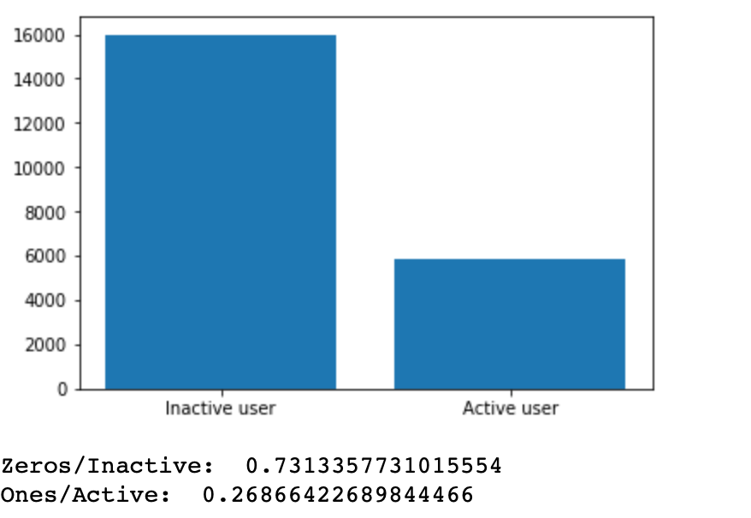
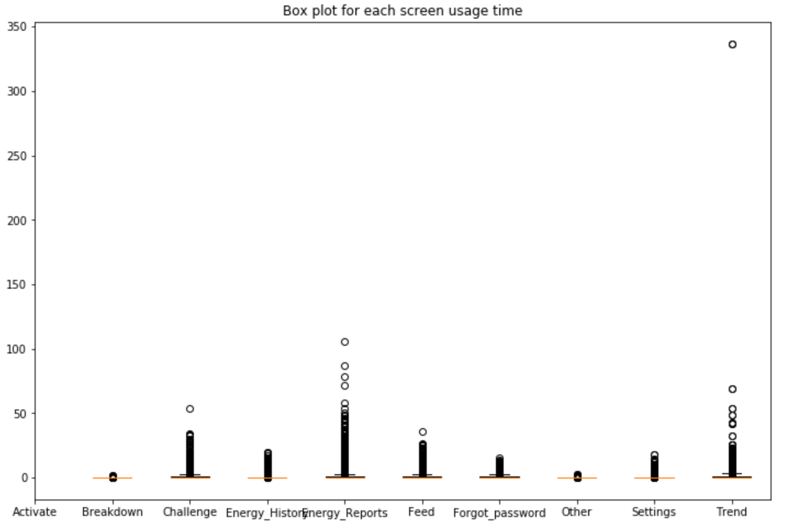
Step 2: Understanding Dataset
The most valuable screen for this app is Energy Reports and Trend. The company should not be spending time on refining breakdown page.
Inbalanced dataset: Inactive 73% vs Active 27%

Slide 5
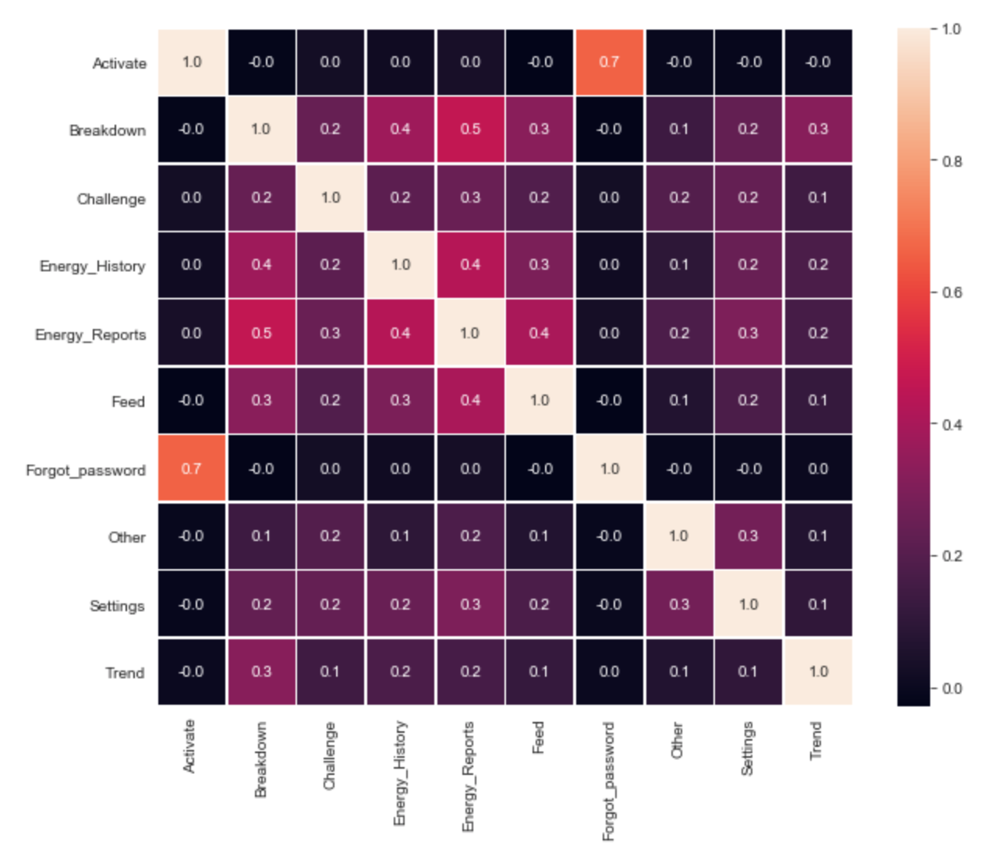
Step 3: Training + Test dataset
For training set: selecting equal number of Inactive vs Active
Examine independence of the variables: couple high correlating points, otherwise, independent

Slide 6
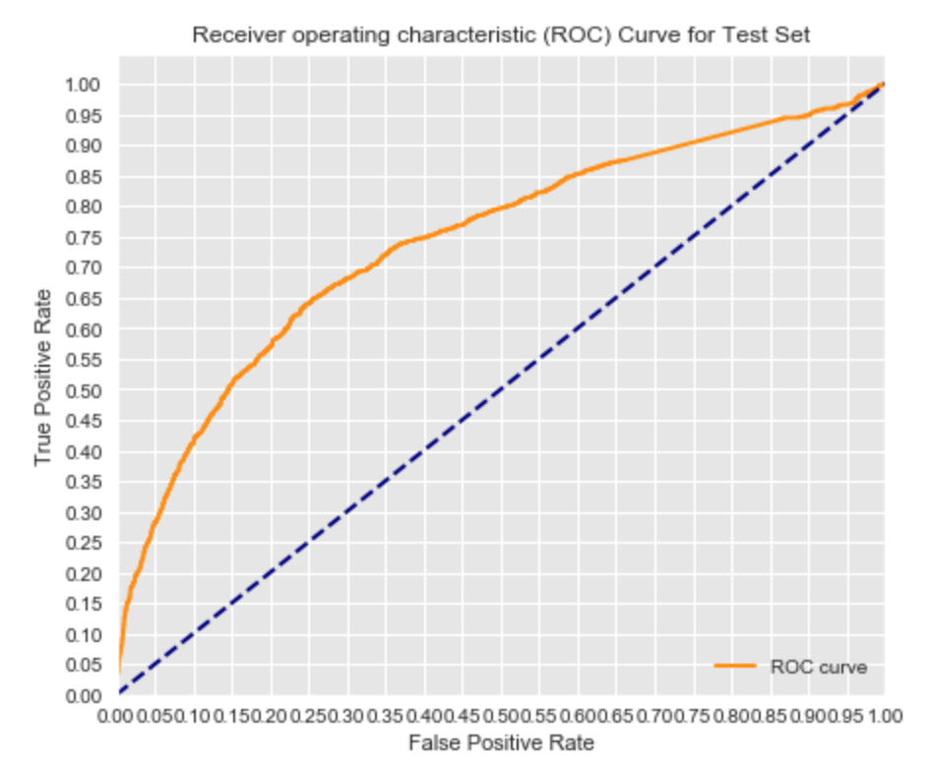
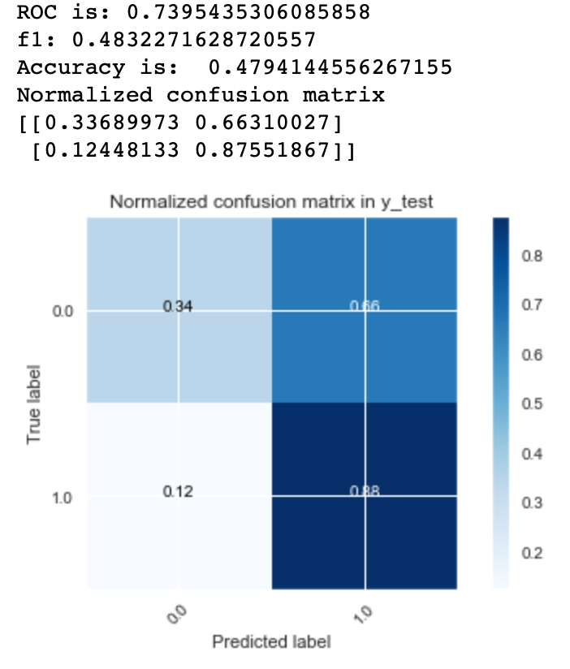
Step 4: Modeling: Logistic Regression
Logistic Regression F1 Score is not great
Confusion Matrix suggested that the model is very good at predicting True Positive (ie when someone is active).

Slide 7
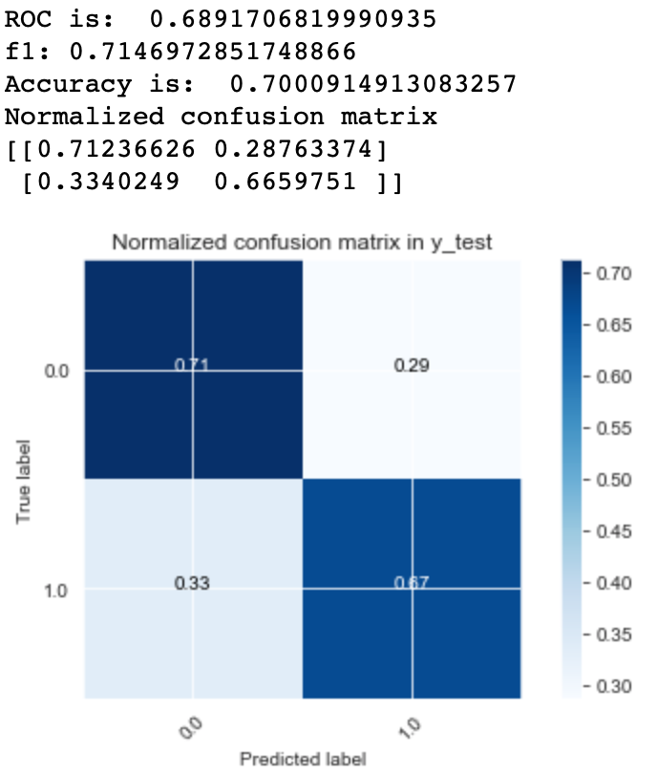
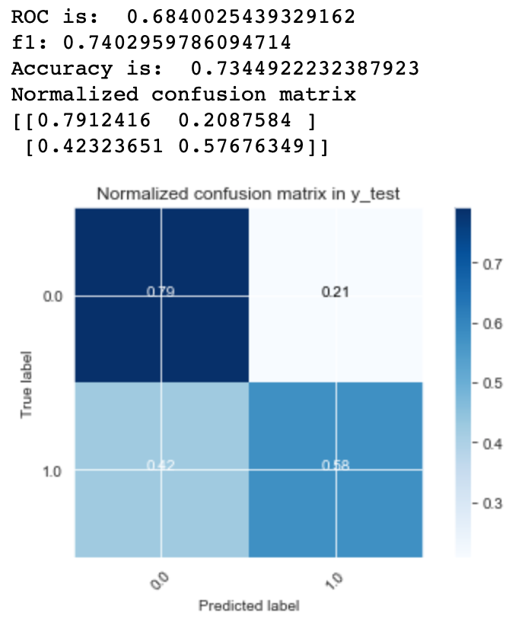
Step 4: Modeling: Decision Tree
Decision Tree significantly improved F1 score.
Especially in predicting True Negative.
Between Default Model and Optimized model, Optimized model does a better job in predicting accuracy and f1.
However, it is worth noting that Optimized model did worse in predicting True Positive vs Default Model.
Default Model
Optimized Parameters

Slide 8
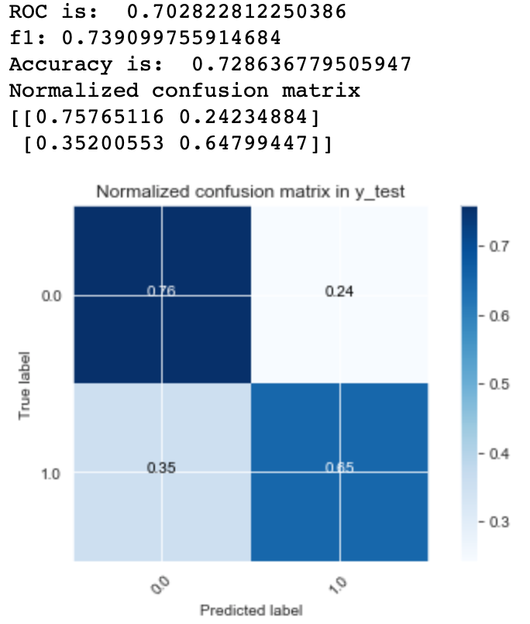
Step 4: Modeling: Random Forest
Random Forest with grid search
Same f1 score as optimized Decision Tree, but better at predicting True Positive.

Slide 9
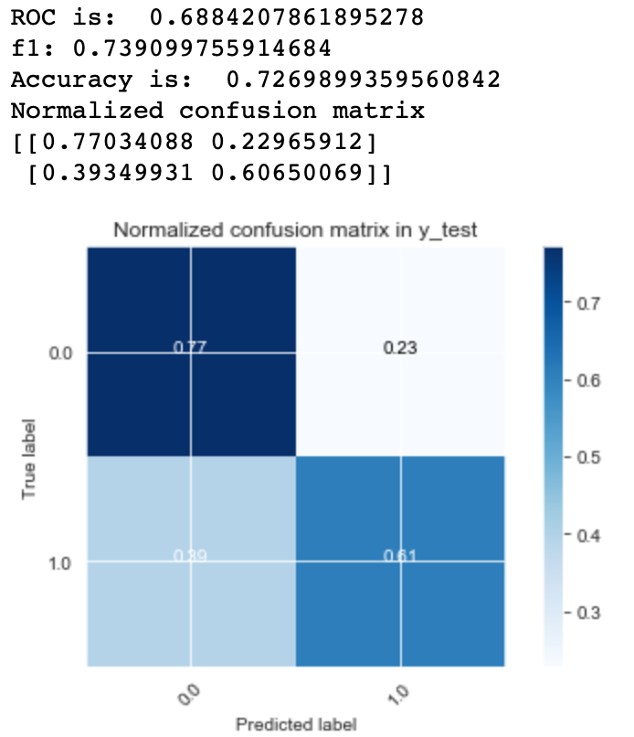
Step 4: Modeling: Ada boosting
Ada boosting with default parameter
Same f1 as Random Forest, and marginally lower by 1% in ROC

Slide 10
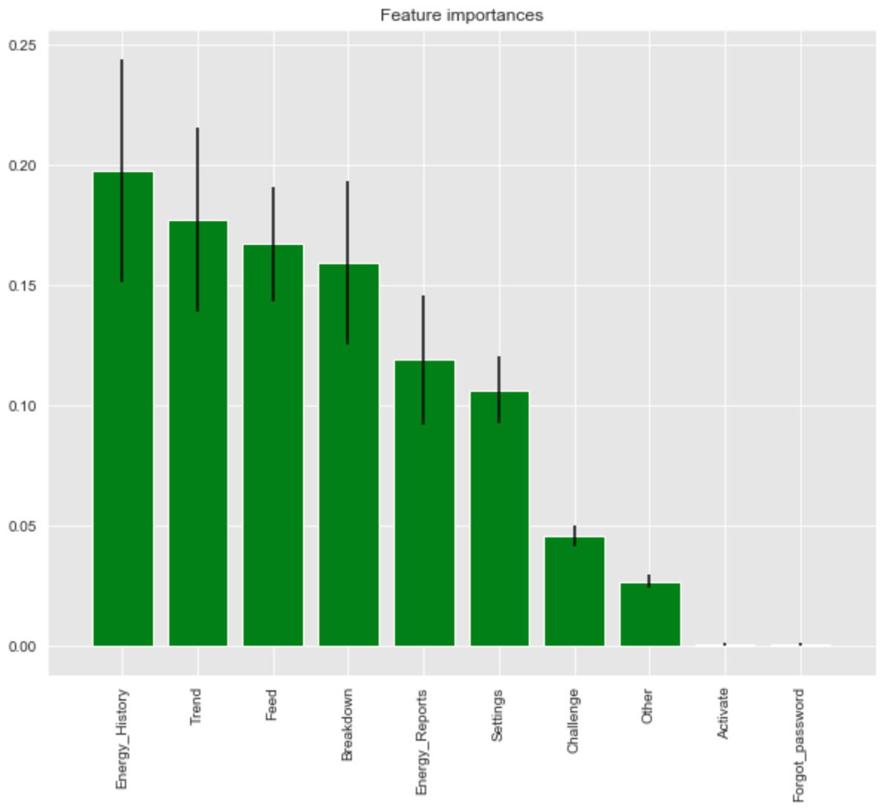
Summary of Model Results
Random Forest produced the best f1 Score and AUC, albeit the difference between Decision Tree, Random Forest and Ada Boosting are negligible.
In the Random Forest Model, top 4 feature screens of the app explains more than 50% of the outcome: trend, Energy History, and feed.

Slide 11
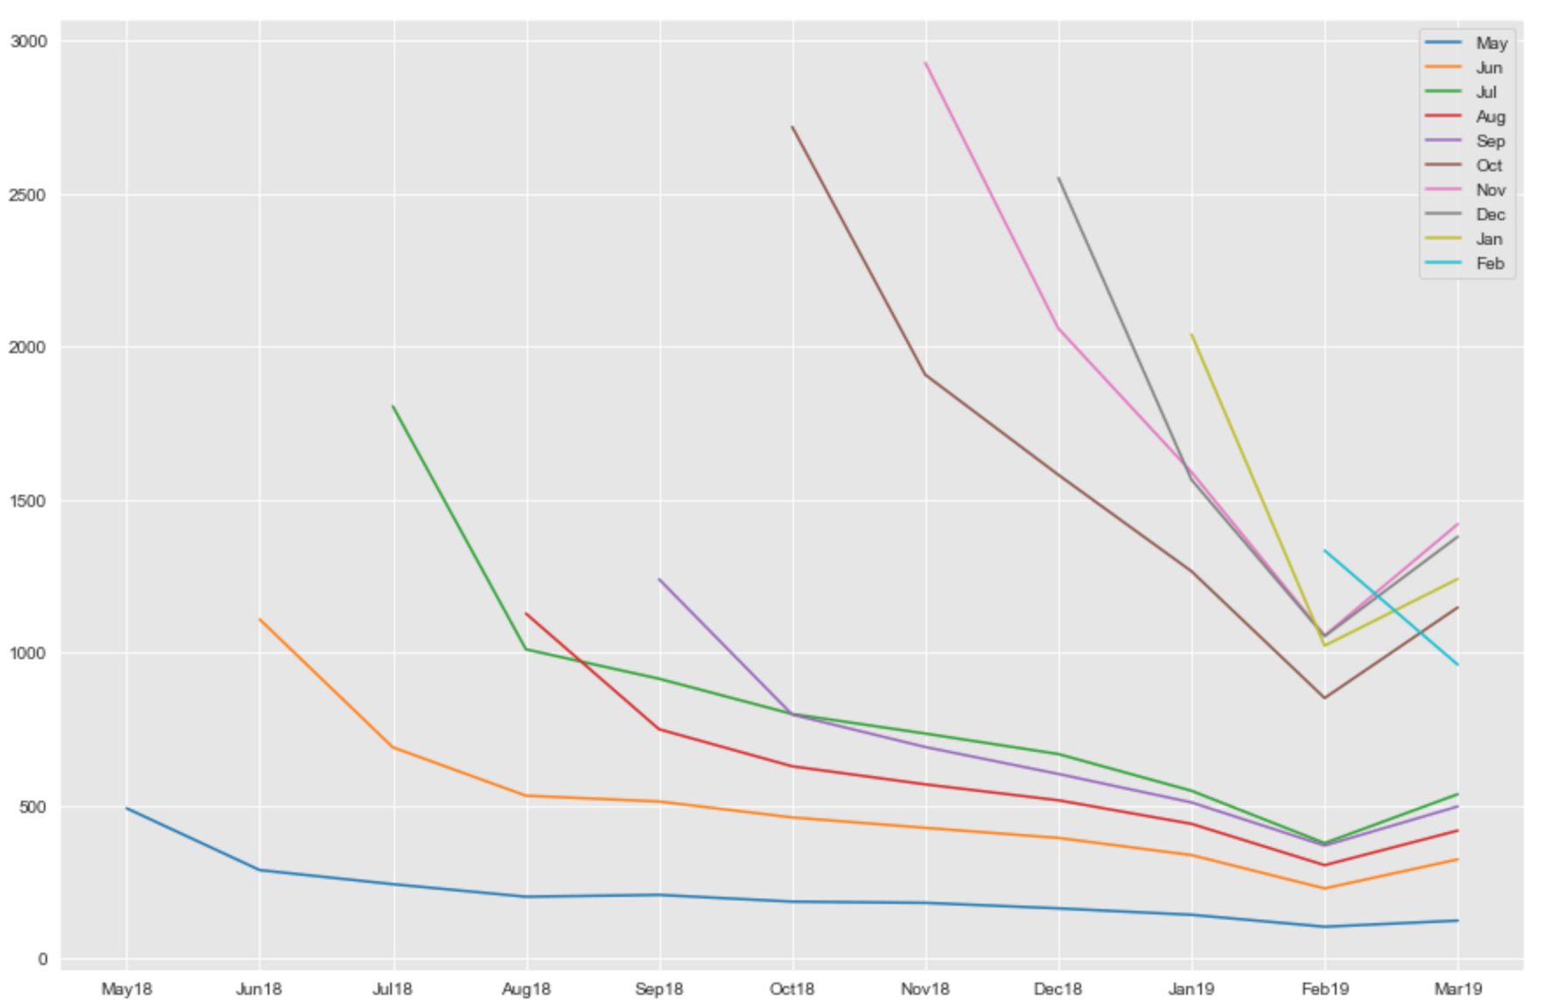
Business Implication
The company should focus design effort on Energy Report, Trend and feed pages of the app, and spend less time on the rest.
There are a large number of users becoming inactive. Further cohort Analysis suggested that about 25% of user remain active after couple months of using it.
If the company wants to improve user usage, they could prompt with feeds relevant to the user, if the model indicates that the user is likely to become inactive next month.
In conclusion, this is not a sticky app for the consumer. Little evidence of usefulness. The company’s value proposition needs to be re-assessed.
Cohort Analysis: 75% user becomes inactive over time.

